Slide 1
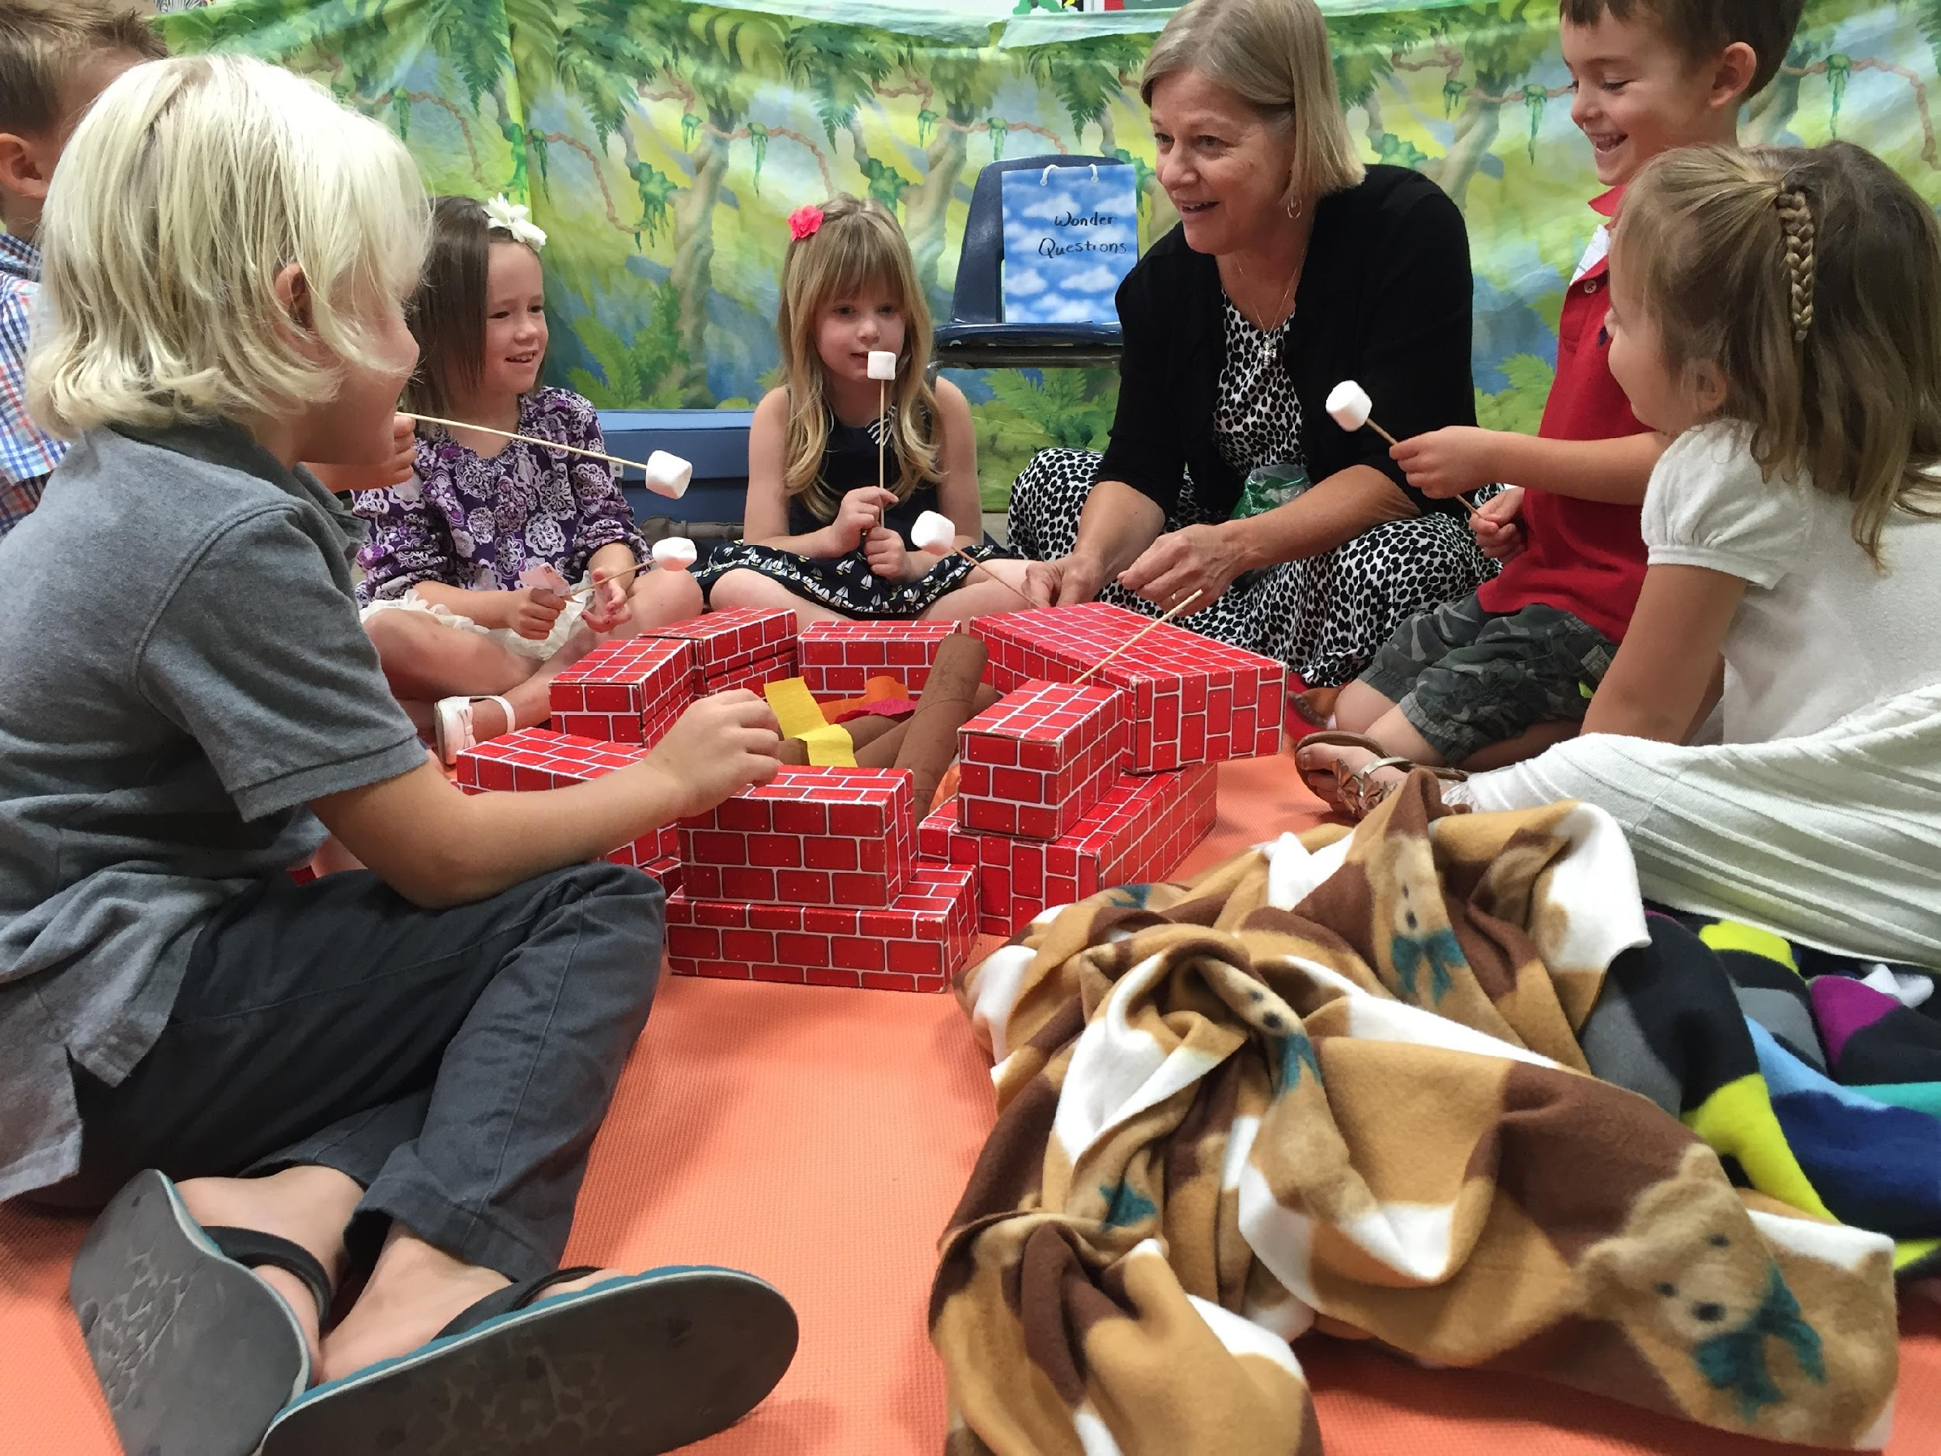
KIDStory@Church:
A Roadmap to Success

Slide 2
CNUCME
UNDRDC
W84IT
WAIT FOR IT
CAN YOU SEE ME?
UNDER THE SEA
BMYVTINE
IMLT8AGN
ANWSTRT
BE MY VALENTINE
I AM LATE AGAIN
A NEW START

Slide 3
KIDStory@Church:
A Roadmap to Success

Slide 4
Joan Stevenson

Slide 5
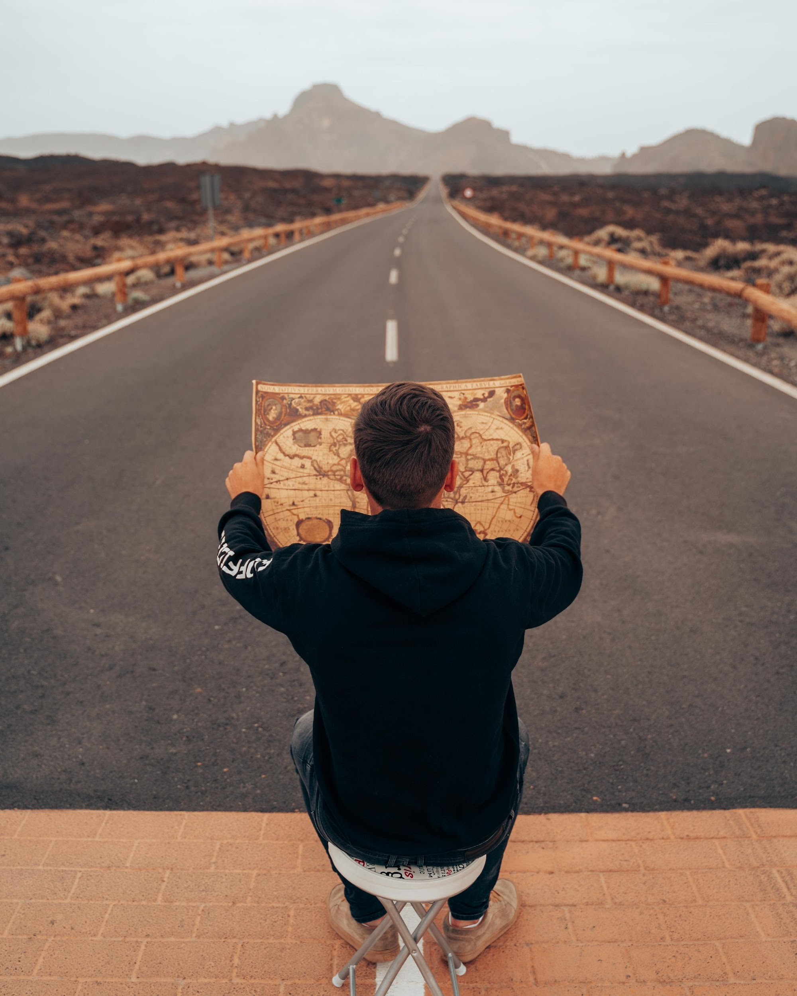
Breakout Room
Introduce Yourself and the ministry you serve in.
Share the most memorable trip you have taken.

Slide 6
KIDStory is _______________

Slide 8
Bumpy and Windy Roads

Slide 9
CORE ESSENTIALS
Relational
Bible Centered
Spirit Led
FUN
Reproducing

Slide 11
Pg 4
The bumps I am experiencing are ________

Slide 12
Fork in the Road
What decisions do we need to make?
What options do we have?
Pg 5

Slide 14
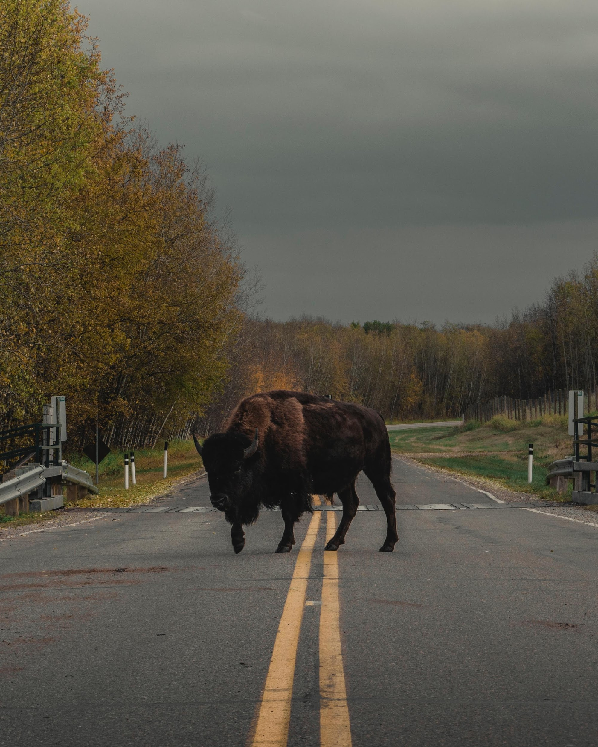
Obstacles

Slide 15
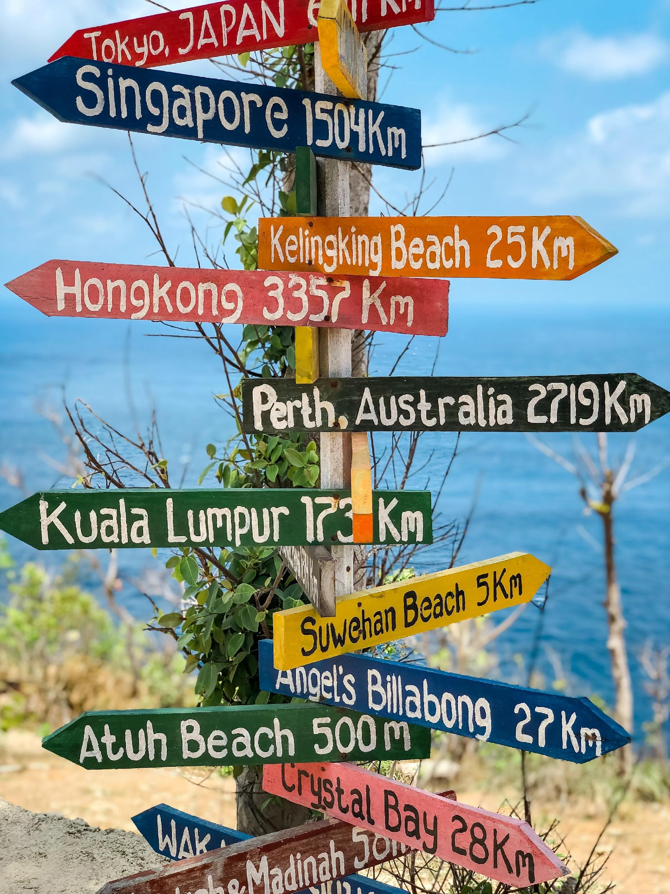
Why choose KIDStory

Slide 16
CORE ESSENTIALS
Relational
Bible Centered
Spirit Led
FUN
Reproducing

Slide 18
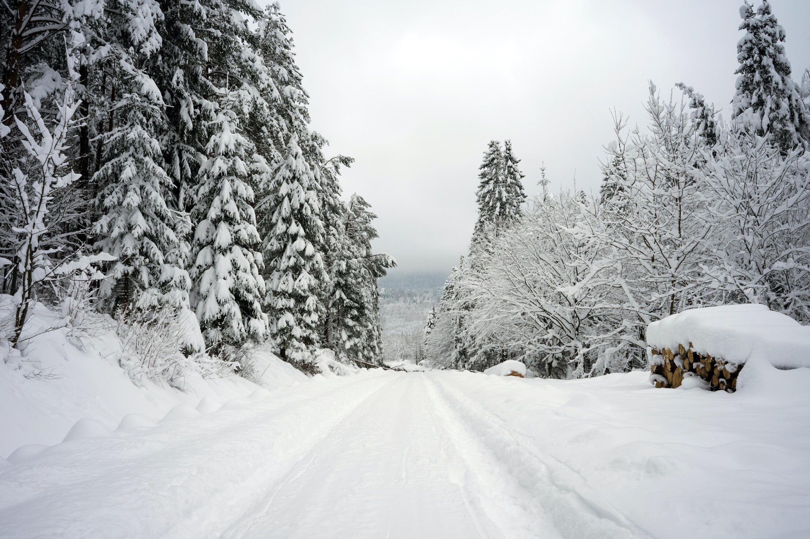
My current obstacles are ……
Pg 6

Slide 20
Slow Down
Communication
Change?
Appreciation
Pg 7

Slide 22
Resume Speed
Adopt
Adapt
Apply
Pg 7

Slide 23
Pg 8

Slide 24
For more information go to:
KATW.org

