Slide 1
Start a StoryClub

Slide 2
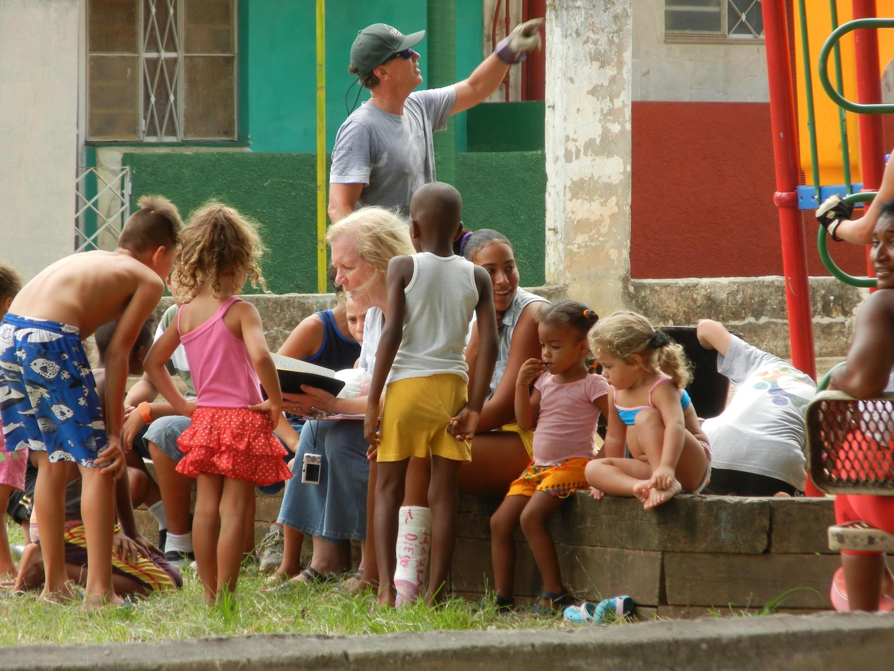

Slide 3
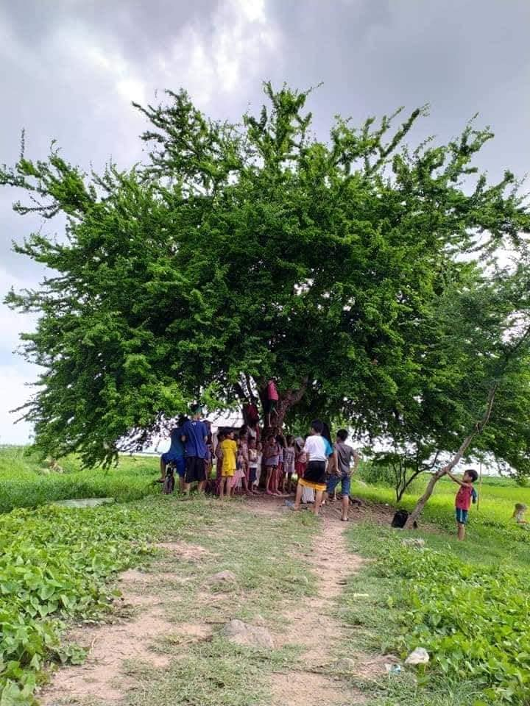

Slide 4
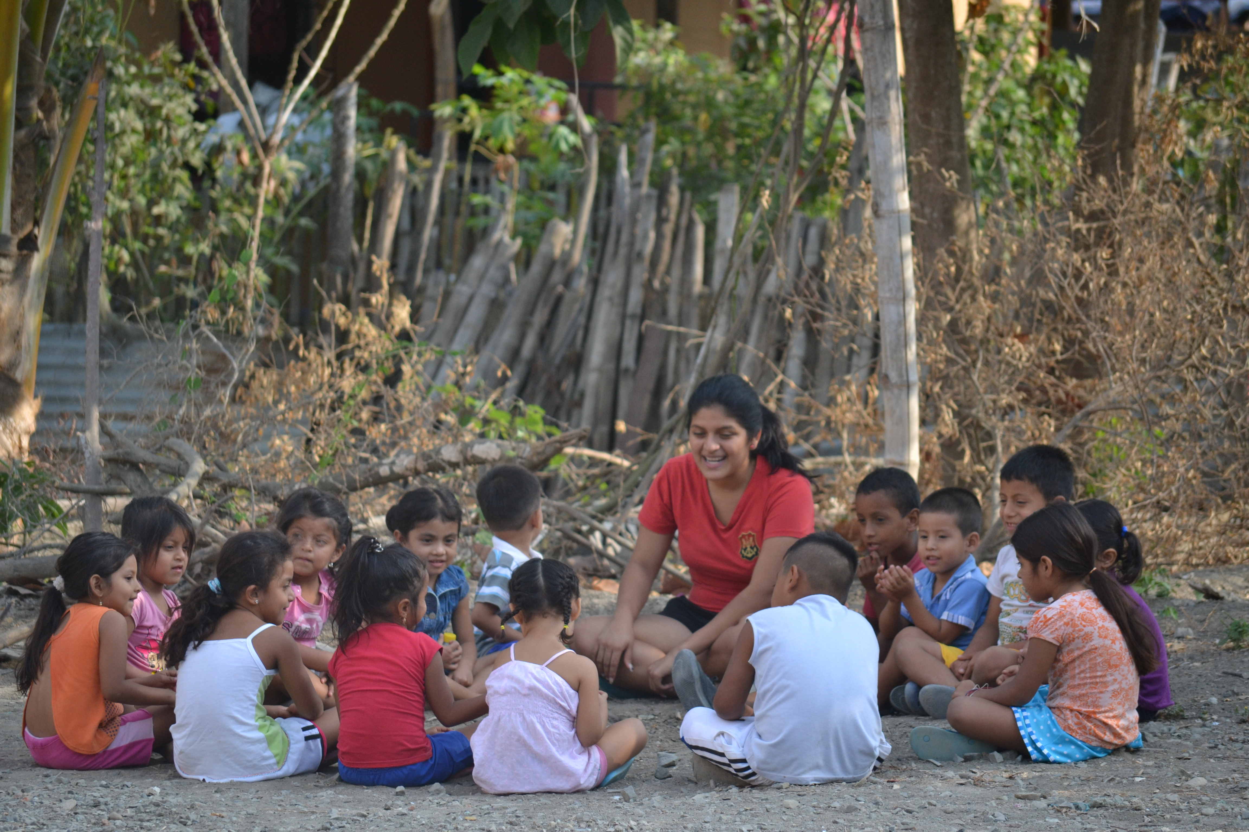

Slide 5
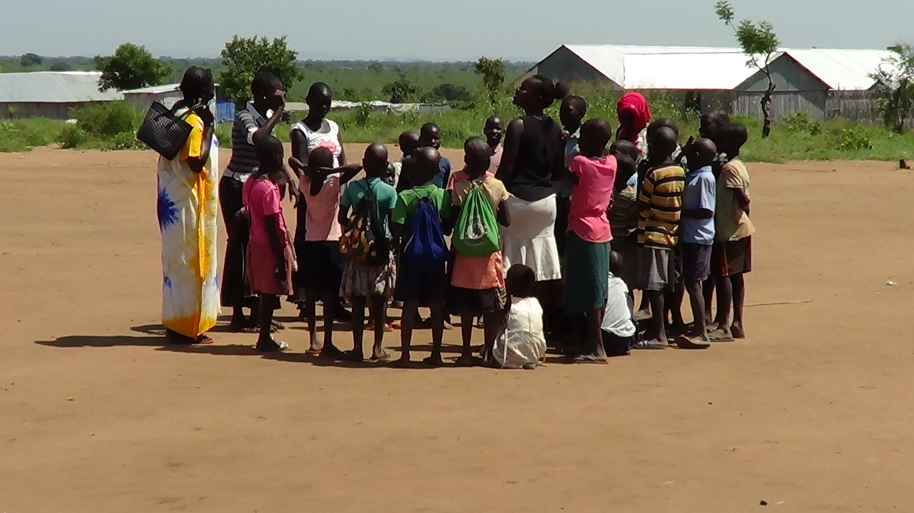

Slide 6
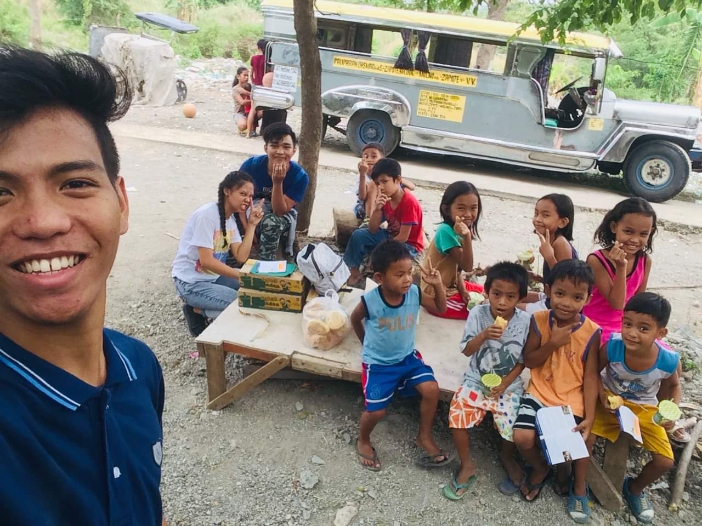

Slide 7
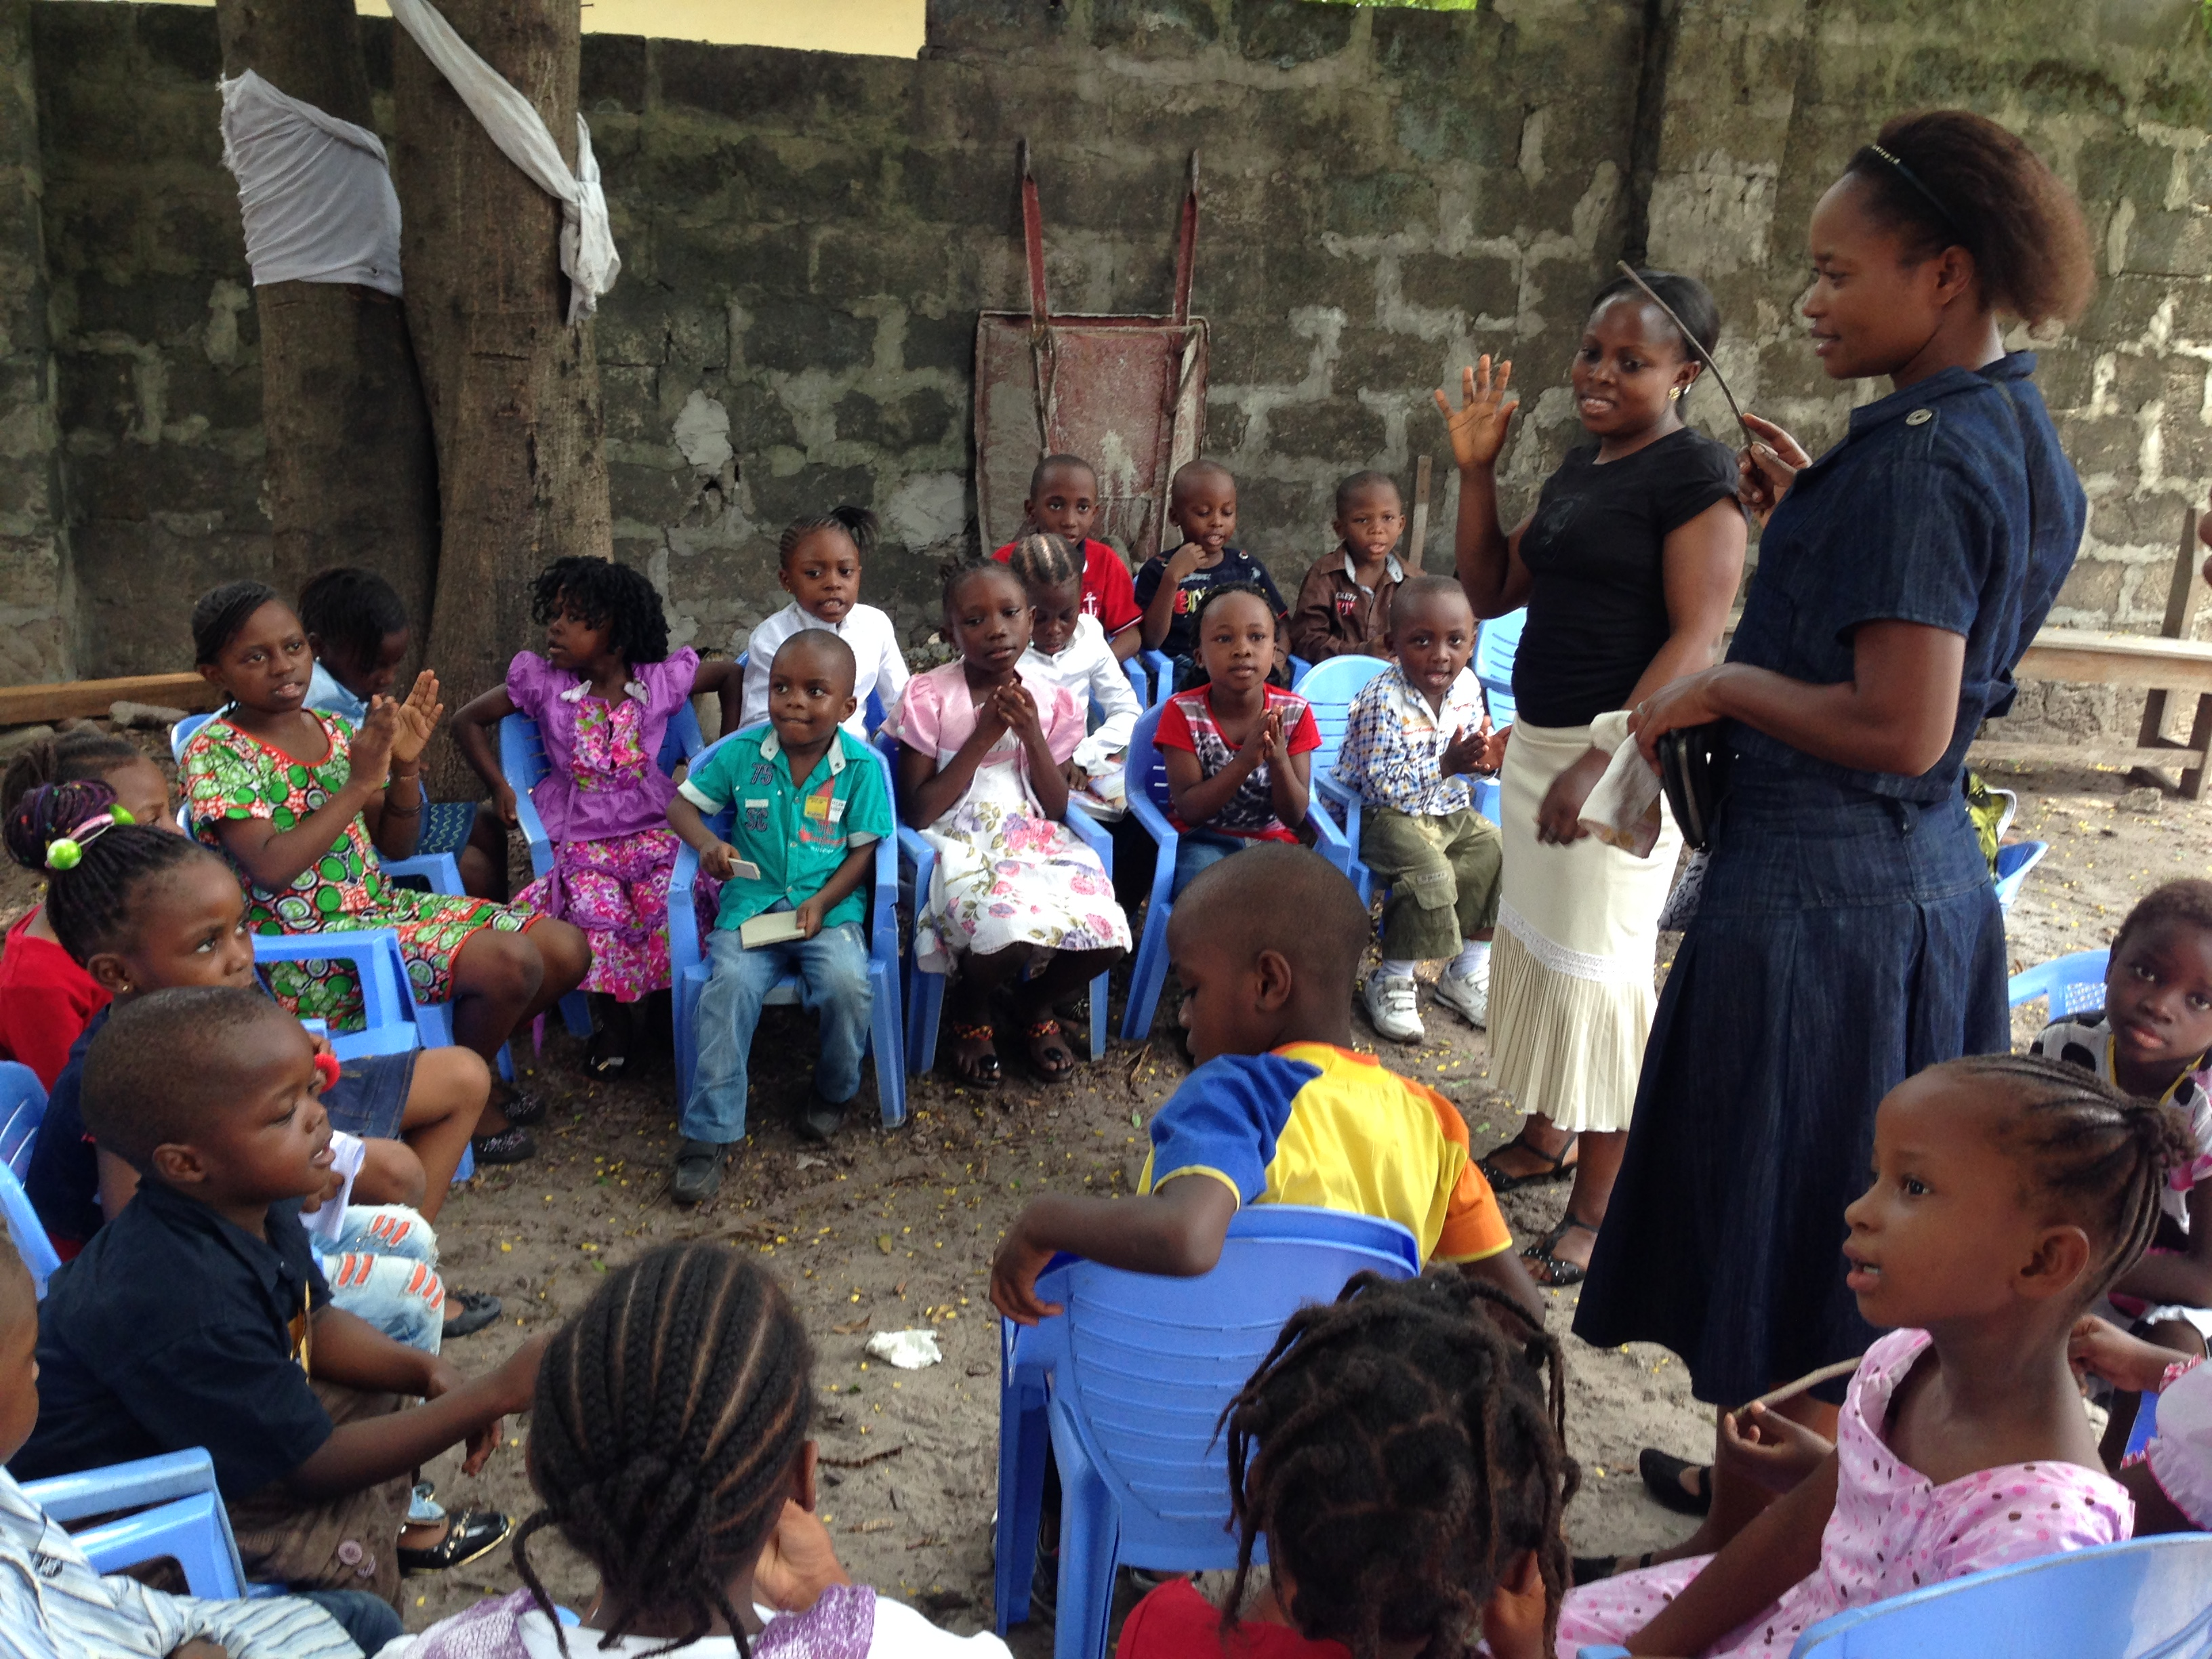

Slide 8
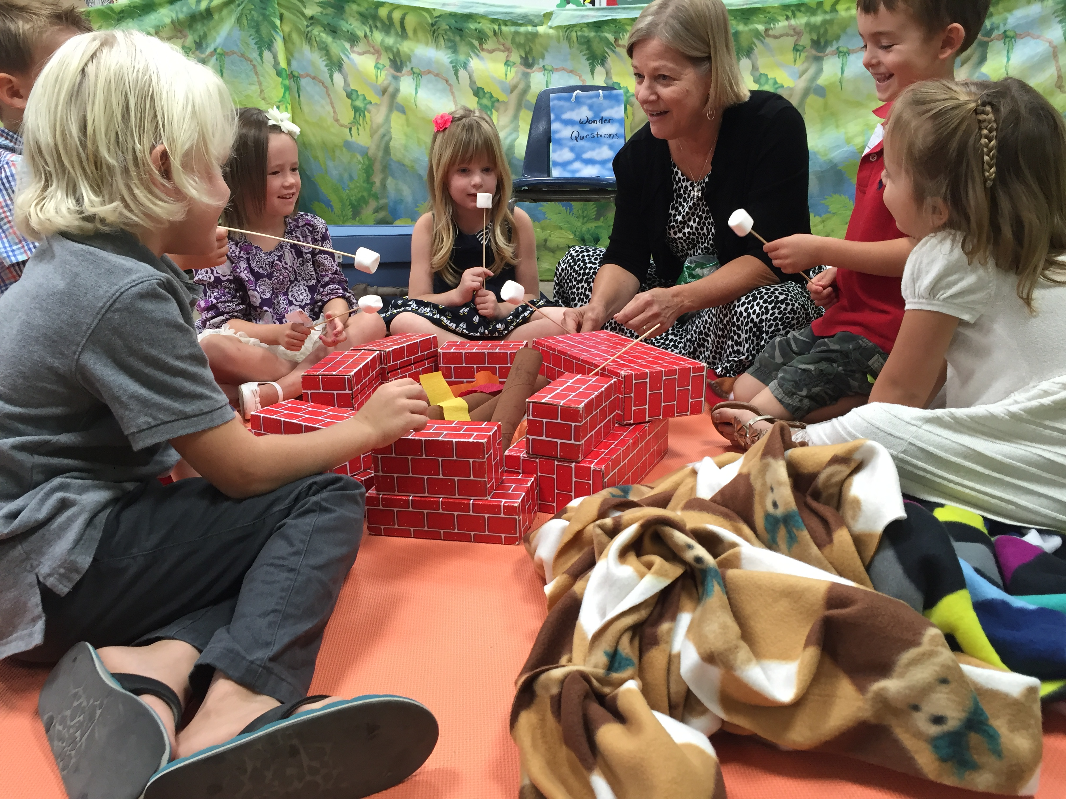

Slide 9
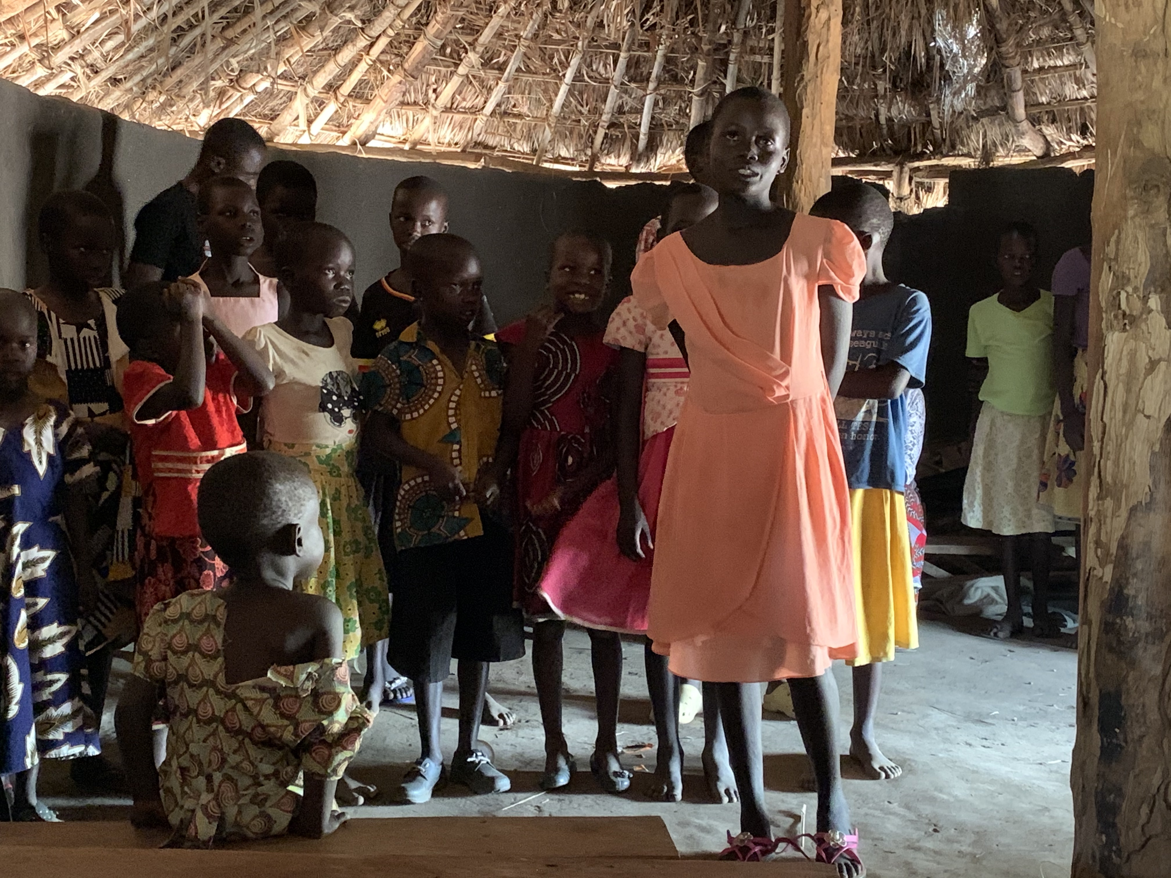

Slide 10
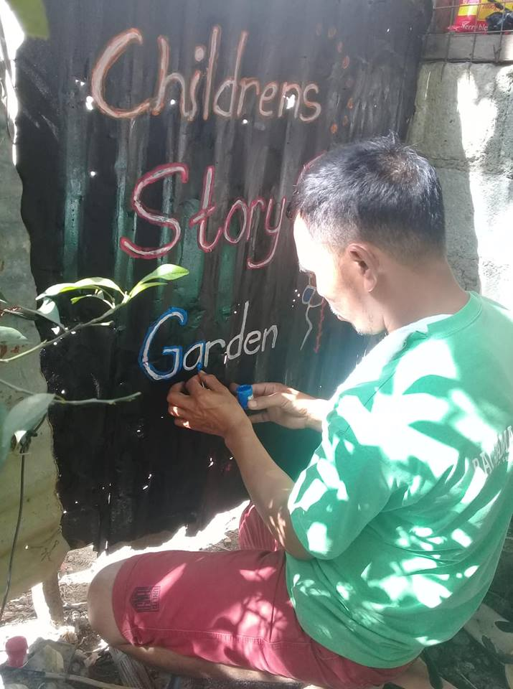

Slide 11
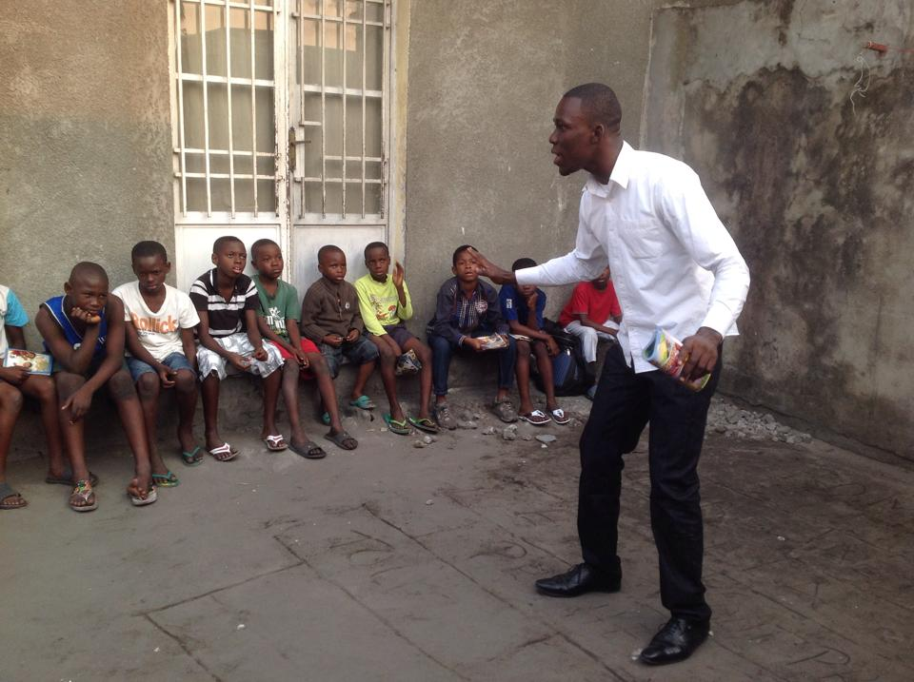

Slide 14
Page 4

Slide 15
Welcome

Slide 16
Welcome | KidConnect

Slide 17
Welcome | KidConnect | Play

Slide 18
Welcome | KidConnect | Play | Worship

Slide 19
Welcome | KidConnect | Play | Worship | Story

Slide 20
Page 4

Slide 21
ReTell

Slide 22
ReTell | Questions

Slide 23
ReTell | Questions | Blessing

Slide 24
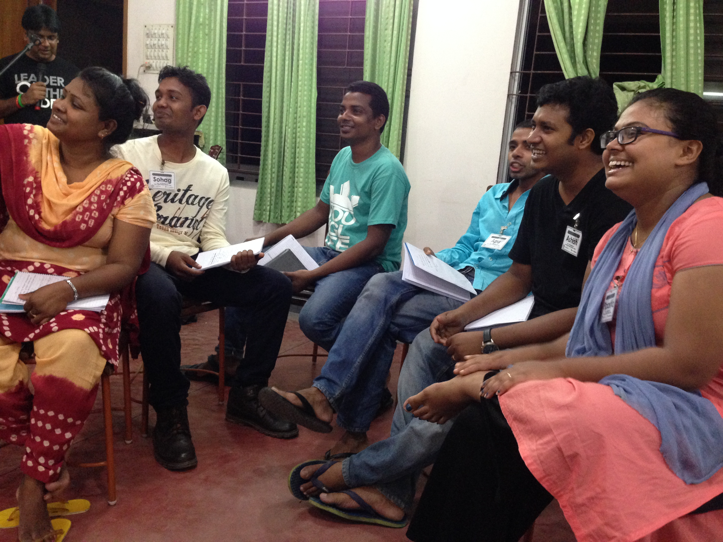

Slide 25
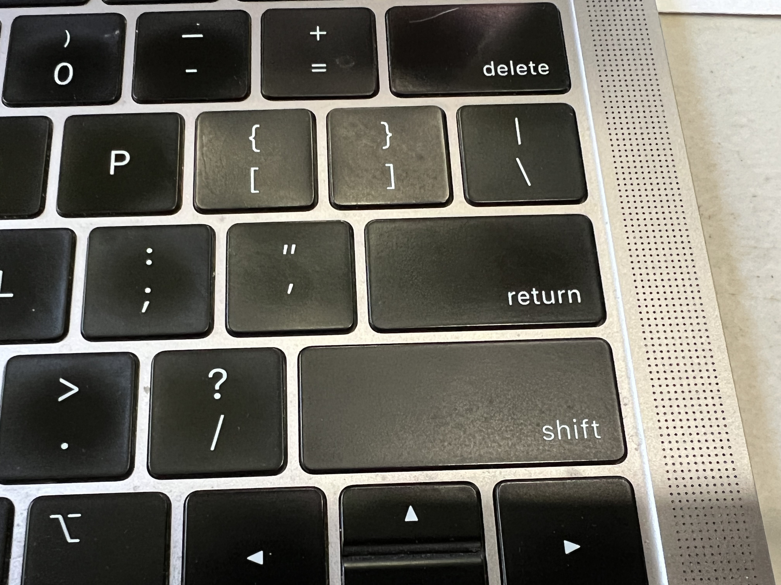
Page 5

Slide 26
Shift Key - One thing talked about today that is shifting how you are thinking or planning on doing ministry is …
Quotation Mark: What is a key statement or idea you found instructive or informative?
Return Key: When the kids return to your StoryClub, one thing they will notice that is different is …
Delete Key: What will you stop doing?

