Slide 1
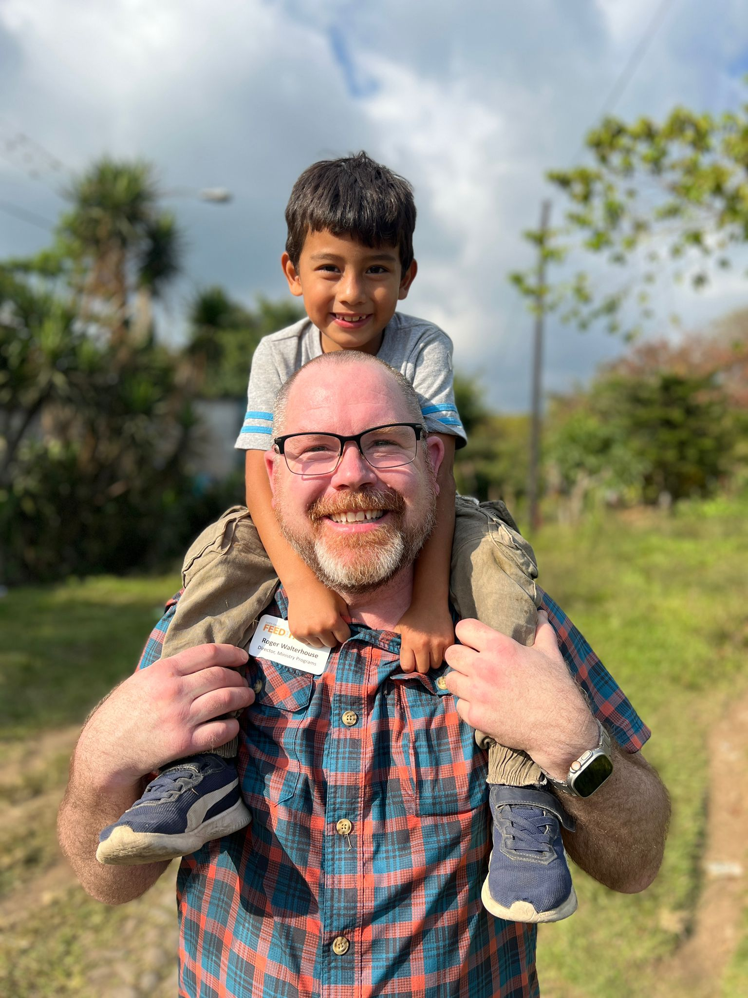
Crafting a Joyful Word in a Joyless World

Slide 2
K. T. L. V. E. R. A. G. E. G. C. S
C. A. N. C. X. B. W. R. C. N. D. G
J. S. A. E. U. O. X. A. N. I. C. N
P. R. O. S. M. Z. Q. C. U. H. H. I
G. M. E. T. K. T Q. E. O. G. I. T
R. O. B. B. E. R. N. F. B. U. L. O
T. C. O. S. T. U. M. E. S. A. D. O
K. J. J. D. H. U. C. H. T. L. Y. H
T. N. E. M. N. O. R. I. V. N. E. S
Q. D. N. R. S. E. M. Y. O. J. O. W
X. Z. C. F. L. G. W. Q. Q. R. O. C
E. A. L. I. N. G. S. G. T. Z. U
ABUSE
CONTENTMENT
GOODNEWS
HEALING
ROBBER
BOUNCE
COSTUMES
GRACE
JOY
SHOOTINGS
CHILD
ENVIRONMENT
GRACE
LAUGHING

Slide 3
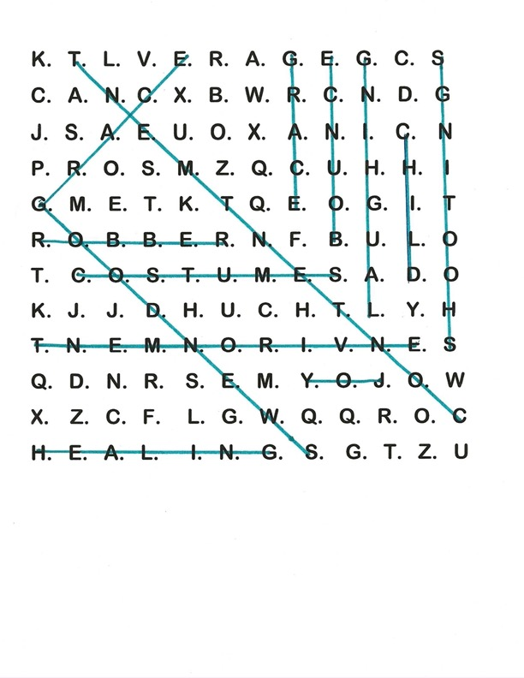
ABUSE
CONTENTMENT
GOODNEWS
HEALING
ROBBER
BOUNCE
COSTUMES
GRACE
JOY
SHOOTINGS
CHILD
ENVIRONMENT
GRACE
LAUGHING

Slide 4
Crafting a Joyful Word in a Joyless World

Slide 5
Roger Walterhouse
Director, Ministry Programs
Feed the Hungry

Slide 6
Breakout Rooms
Share who you are and where you serve
What does joy mean to you?

Slide 7
Crafting a Joyful Word in a Joyless World

Slide 8
BIG IDEA:
Purposely planning joy into your environment and KIDStory lesson will significantly enhance life transformation.

Slide 9
The World Kids Live In
True or False
In the US alone, 140,000 children lost their primary or secondary caregiver
to covid

Slide 10
The World Kids Live In
True or False
Just in the state of Oregon, the rate of suicide of 10-12 year olds increased 500% from 2017 to 2021

Slide 11
The World Kids Live In
True or False
The number of reported child abuse cases increased in the 14 months following the 2020 lockdown.

Slide 12
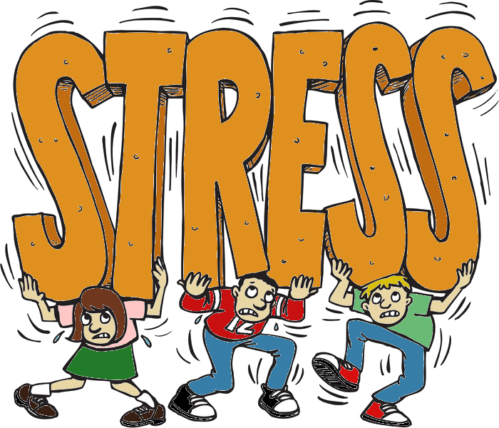

Slide 13
What is JOY?!!!

Slide 14
Xara- Joy- to be favorably disposed towards God’s grace
To bounce

Slide 15
When There is Joy …
Dopamine
Lymbic System
Endorphines
Oxytocin
Page 4

Slide 16
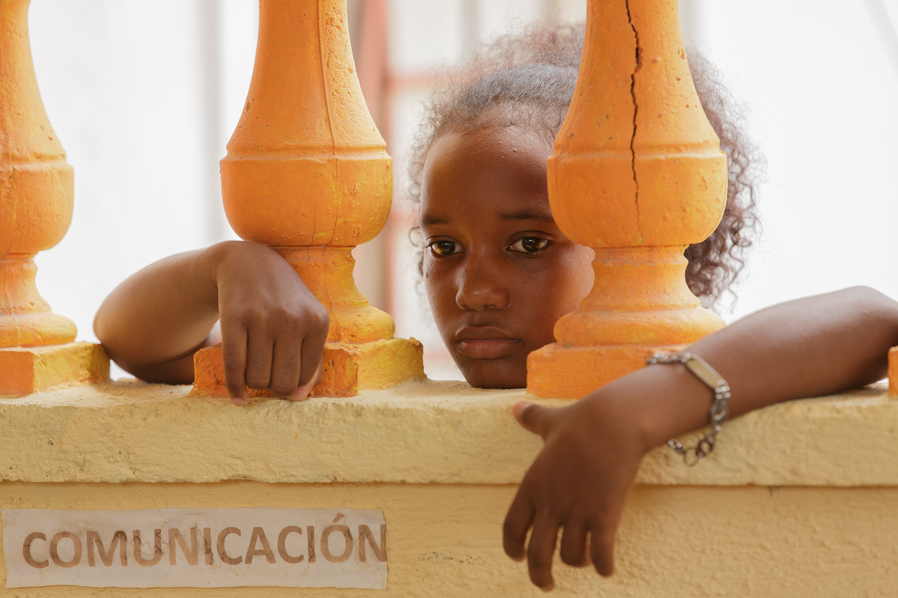
JOY ROBBERS

Slide 17






Death
Suicide
Abuse
Porn
War
Shootings
Page 5

Slide 18
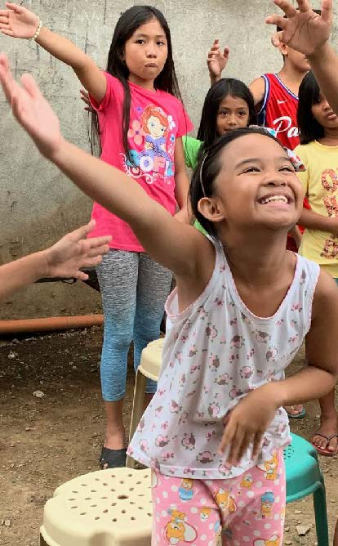
GOOD NEWS!!

Slide 19
John 16:33 (NIV)
“I have told you these things, so that in me you may have peace. In this world you will have trouble. But take heart! I have overcome the world.”

Slide 20
Θλῖψις- “trouble”
to hem in, back into a corner, present no way out, create undue pressure

Slide 21
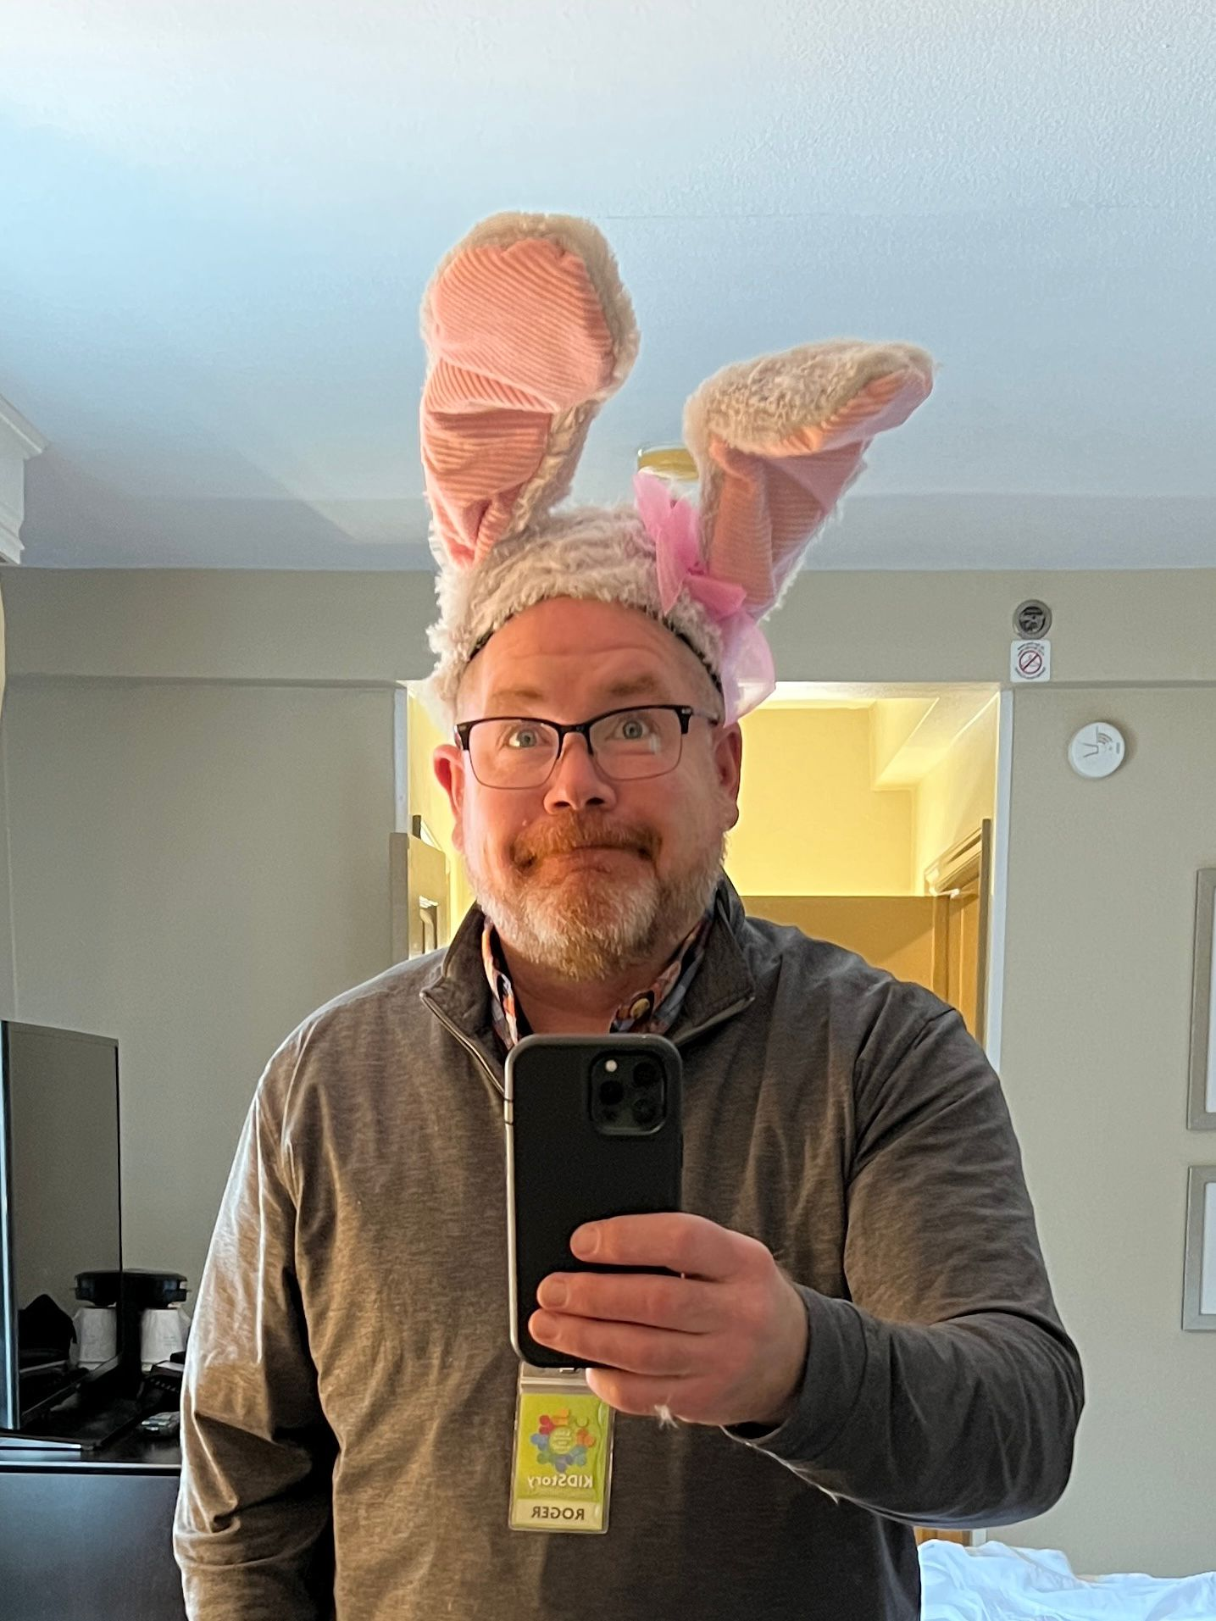
MORE
GOOD NEWS!!

Slide 22
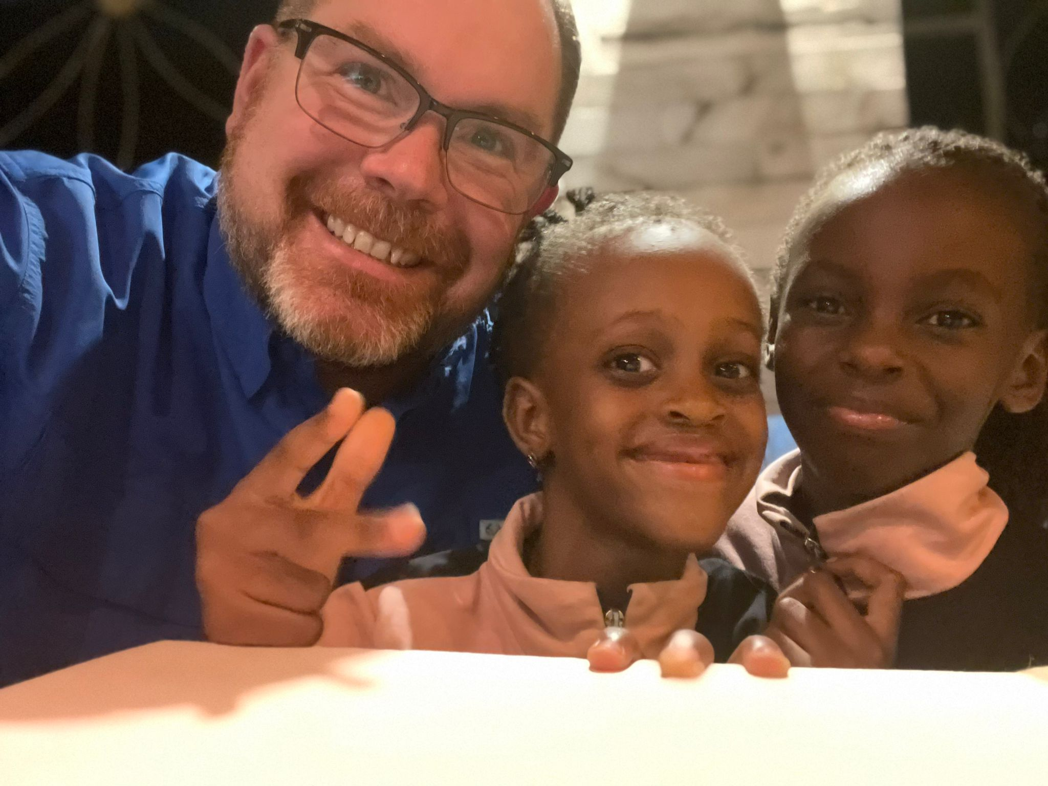
One of the greatest gifts you can give a child is an environment of supercharged joy.

Slide 23
How God can work through us …

Slide 24
A laughing child
is a healing child

Slide 25

6 months later…
Changes made …
Changes seen…
Page 9

Slide 26

“Bouncing balls are one of the most powerful preventative medicines on planet earth.” Dr. Rachel Crowder

